Slide 1


Slide 2
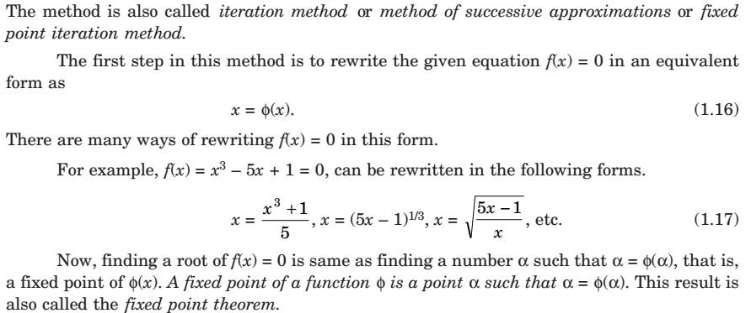

Numerical Methods
National University of Science and Technology, Islamabad

Slide 3
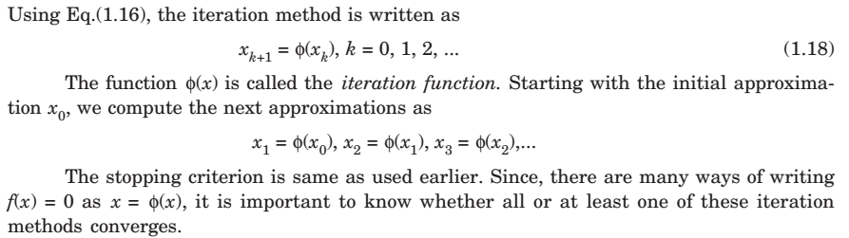
Numerical Methods
National University of Science and Technology, Islamabad

Slide 4
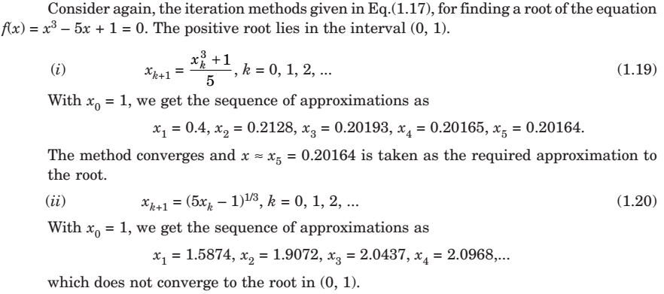
Numerical Methods
National University of Science and Technology, Islamabad

Slide 5
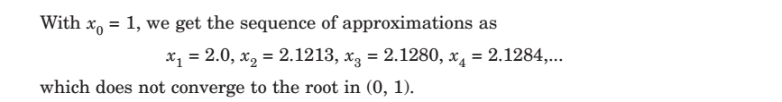
Numerical Methods
National University of Science and Technology, Islamabad

Slide 6
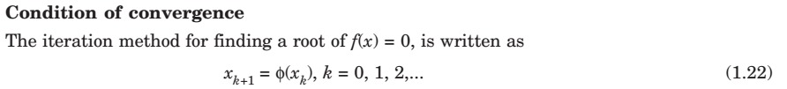
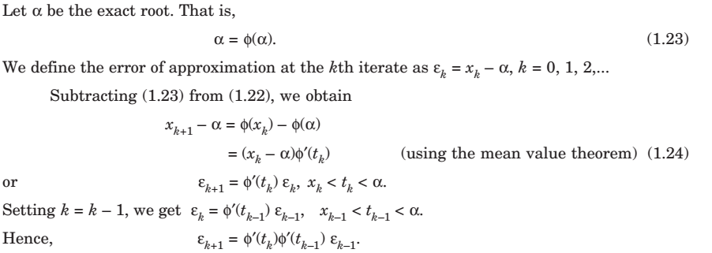
Numerical Methods
National University of Science and Technology, Islamabad

Slide 7
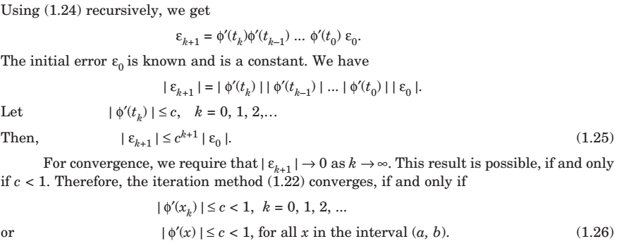
Numerical Methods
National University of Science and Technology, Islamabad

Slide 8
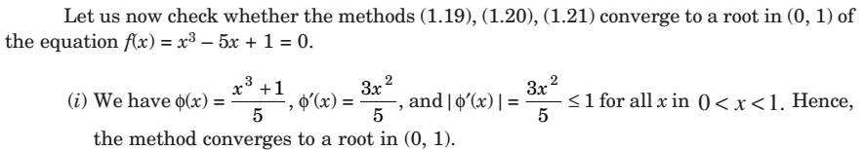
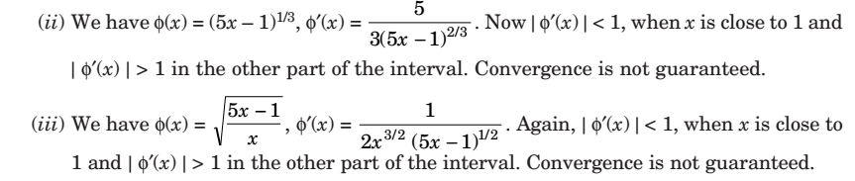
Numerical Methods
National University of Science and Technology, Islamabad

Slide 9
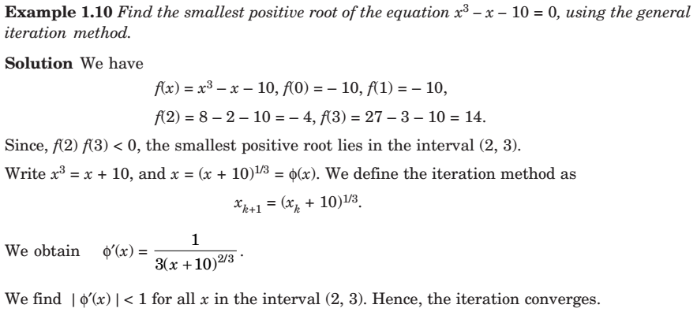
Numerical Methods
National University of Science and Technology, Islamabad

Slide 10
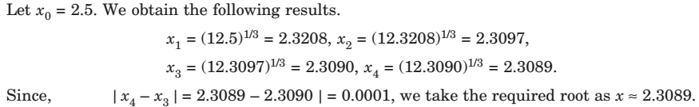
Numerical Methods
National University of Science and Technology, Islamabad

Slide 11

Numerical Methods
National University of Science and Technology, Islamabad

Slide 12

Numerical Methods
National University of Science and Technology, Islamabad

Slide 13
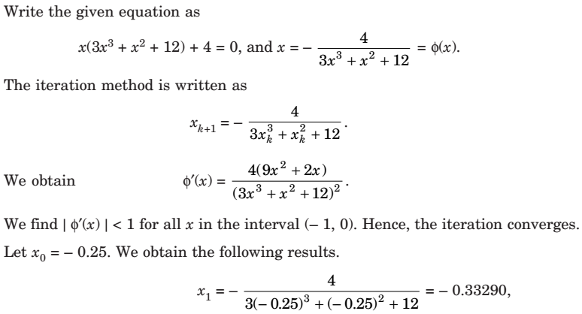
Numerical Methods
National University of Science and Technology, Islamabad

Slide 14
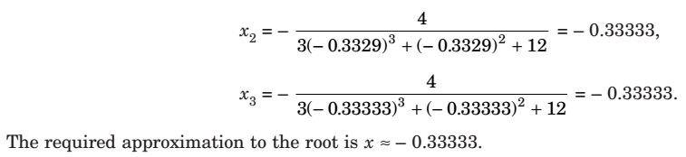
Numerical Methods
National University of Science and Technology, Islamabad

Slide 15
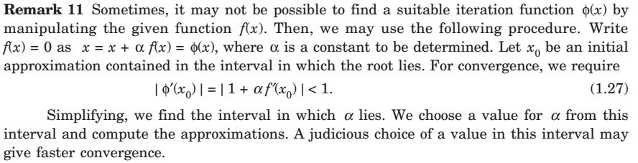
Numerical Methods
National University of Science and Technology, Islamabad

Slide 16
Numerical Methods
National University of Science and Technology, Islamabad

Slide 17
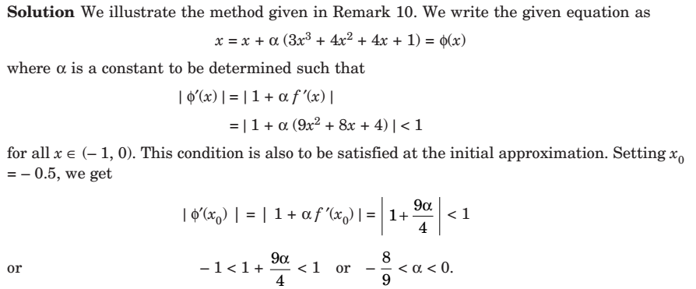
Numerical Methods
National University of Science and Technology, Islamabad

Slide 18

Numerical Methods
National University of Science and Technology, Islamabad

Slide 19
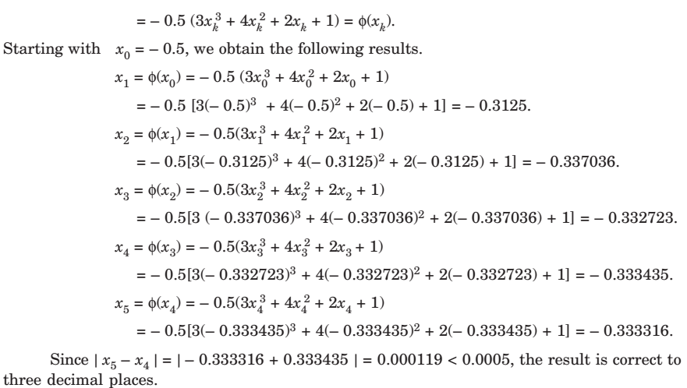

Numerical Methods
Quaid-i-Azam University
Department of Mathematics
National University of Science and Technology, Islamabad

Slide 20
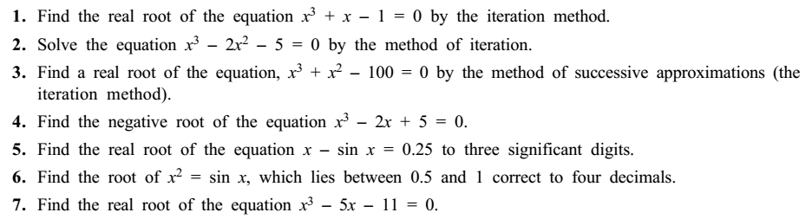
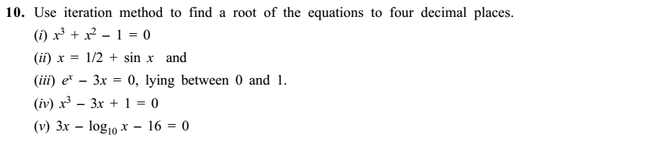
Numerical Methods
Quaid-i-Azam University
Department of Mathematics
National University of Science and Technology, Islamabad

